Slide 1









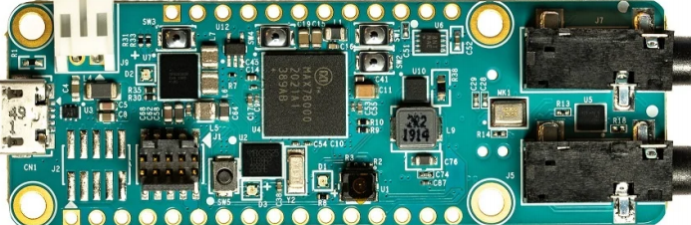


Food Detection System
Chujie Guan (EE)
cxg170008@utdallas.edu
Jordan Rider (CE)
jlr170230@utdallas.edu
Mariela Ramirez (CE)
mgr170370@utdallas.edu
Omar Resendiz (CE)
oxr170230@utdallas.edu
Karthik Gopan (CE)
kxg174030@utdallas.edu
EE/CE 4488 / Summer 2021
Department of
Erik Jonsson School of Engineering & Computer Science
The University of Texas at Dallas
Richardson, TX 75080, USA
Background
The popularity of Deep Learning to analyze data is on the rise. There is an increasing importance of image processing in the field of science and technology such as computer vision, face detection, augmented reality, X-rays, and Ultrasonic scanning. These all stand to benefit from being able to operate on a low cost and power efficient device. This project means to showcase the capabilities of low power solutions for Convolutional Neural Networks.
Problem
Current deep learning models are performed on microcontroller devices that are immobile and require high power consumption. Thanks to the MAX78000FTHR, we can perform these tasks with high efficiency and low power, which ultimately paves the future of machine learning on wearable technologies.
Objectives
Train our own AI Neural Network
Design a dataset for the neural network
Synthesize the neural network and verify functionality
Run trained model on MAX78000FTHR board
Accurately detect and identify food types and at least 10 different food classes
Report model performance metrics to terminal
Design
Hardware
EVGA GeForce RTX 3080: Training a Machine Learning model requires raw computing power. With the parallel processing capabilities of GPUs we are able to facilitate machine learning parallelization via GPU acceleration.
Maxim MAX78000FTHR board: Maxim’s ultra low-power board uses an Arm Cortex-M4 processor with an integrated Convolutional Neural Network accelerator.
Adafruit 2.4" TFT LCD with Touchscreen: LCD display that connects to board.
Software
Pytorch: Open source deep learning framework used to develop models.
Conda: Open source package and environment management system.
OpenCV: library focused on real-time computer vision applications.
Ubuntu: Open source operating system on Linux used to run the model training.
Eclipse: An integrated development environment used to debug C code that will run on MAX78000FTHR board.
Imageio: Python library that provides easy interface to read and write wide range of image data.
Nvidia CUDA: A parallel computing platform and programing model developed for general computing on NVIDIA GPUs.
System Design
Training
Dataset will be artificially expanded using Imageio and Opencv to create a training set and test set.
Model will be trained using augmented training set on an Ubuntu machine with our RTX 3080 GPU.
Quantization
Trained model size is too large and must be quantized to produce a smaller model.
Evaluation
Model accuracy will be assessed using the test set.
Model and dataset are subject to be altered based on evaluation results
Synthesis & Deployment
Project will be synthesised in order to operate on MAX78000FTHR board.
Once deployed, the built-in camera will be used to identify food item.
Attached display will show camera feed, label given to food item, and performance metrics
7cm
2.2cm
Fig 1.: Maxim MAX78000FTHR board. Highlighted in red is the built-in camera
Vision for Next Semester
In the upcoming semester, we plan on utilizing previously trained models to identify food types and food items with high accuracy. Our implementation of the software technologies are subject to change if future issues are unable to be resolved in a timely fashion. Our design will allow users to import their own datasets and either train the model with their data or use our trained model. The final goal for next semester is to upload our neural network onto the board, use it to identify real foods, and output results in real time.
Ethics Statement
This project is for educational purposes and improving our understanding of its appropriate applications. We acknowledge that we use open source software and modify some existing code. Our system is designed to function within the scope of our project and is inspired from existing MAXIM projects.
Special Thanks to Our Mentors
Dr. Marco Tacca and Mr. Brian Rush
Notes:
‹#›

